Slide 1
Performance of Flash Flood Guidance System Over West Coast of India During Tropical Cyclone TAUKTAE, Abstract ID 149
149
Seventh WMO International Workshop on Monsoon (IWM-7)
22-26 March, 2022, IMD, MoES, New Delhi, India
Asok Raja S K¹, Rahul Saxena¹, Hemlata Bharwani¹, Deepak Yadav¹. S K Manik¹, A.K Das¹
Brahm PrakashYadav^{1*} and Mrutyunjay Mohapatra¹
¹ India Meteorological Department
Presented by:
asok.rsk@imd.gov.in
Objective of the paper :
To provide location specific flash flood guidance alerts in the form of risks with 24 hour lead time and threats with 6 hour of lead time based on 00, 06, 12 and 18 UTC based deterministic numerical weather forecasts from IMD GFS (12km×12km), Regional NCUM (4km×4km) and Mesoscale IMD WRF (3km×3km), and integrating near real-time gauge observations along with the satellite and DWR rainfall estimates.
The study illustrates the performance of Flash Flood Guidance System (FFGS) at watershed level within sub districts of India in context of the impacts of Extremely Severe Cyclonic Storm TAUKTAE over West Coast of India during 14 to 19 May 2021.

Slide 2
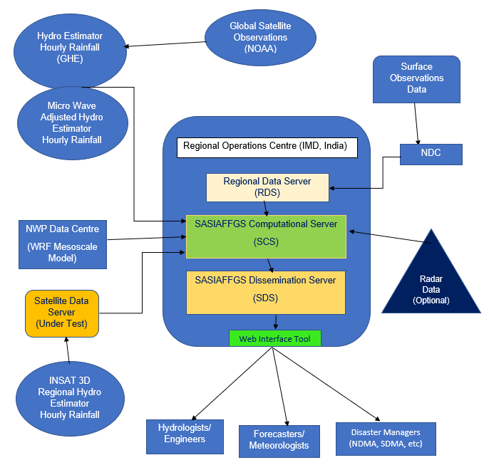
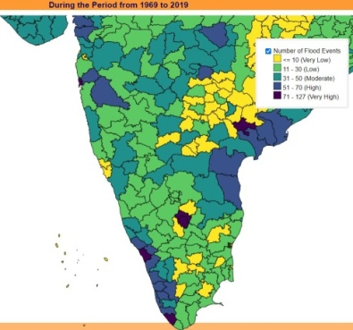
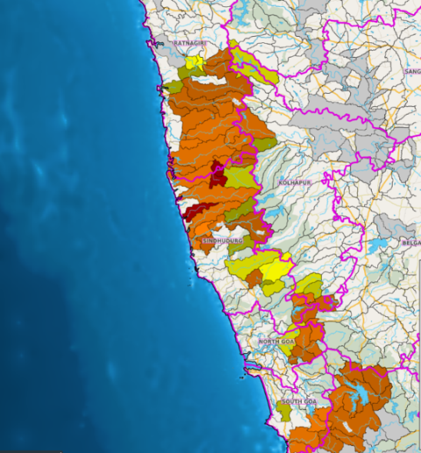
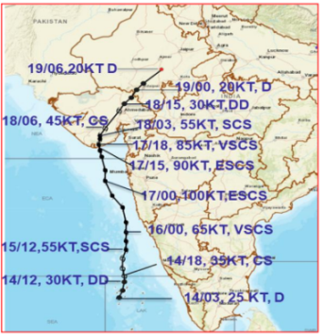
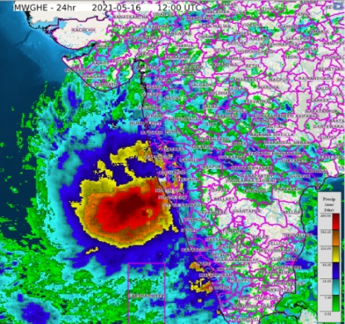
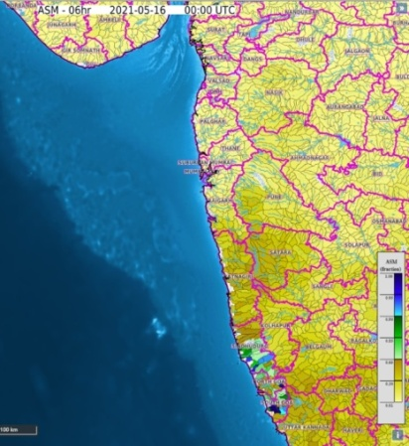
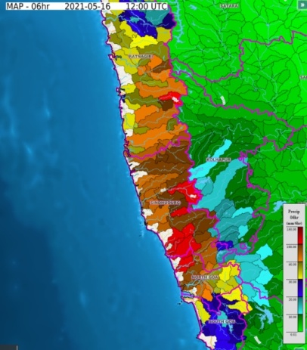
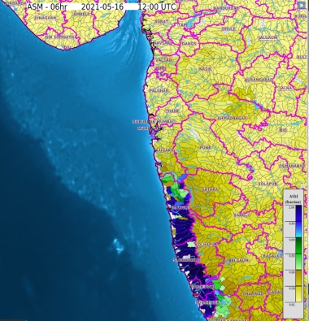
Data & Methodology (For more detailed information: Refer Poster)
149
Threat Based Alerts
Red – High
Orange – Moderate
Yellow - Low
Satellite Rainfall Estimates (mm/hr)
Rathnagiri
Sindhudurg
Cyclone Track
District wise Flood Hazard Map
YOU MAY KNOW
Diagnostic Products: 33
Prognostics Products:18
Threat Products: 12
Risk Products: 9
LSM: SACSMA Lumped Model
Watershed Count: 1 × 10⁵
NWP Model: GFS, WRF & NCUM
Watershed Size : Varying up to 16 sq. km (Vector)
Spatial R: 3km × 3km
Temporal R : Every 6 hours/ Hourly Satellite Update
Static GIS Layers: 10
Host: MAPSERVER
Flash Flood Threat Map
Before Intense Spell
16th May 2021
Soil Saturation was minimum at 00z
After Intense Spell
Fully Soil Saturated at 1200z
Rapid Rainfall Observations up to 180 mm by 1200 UTC over Coastal districts

Slide 3
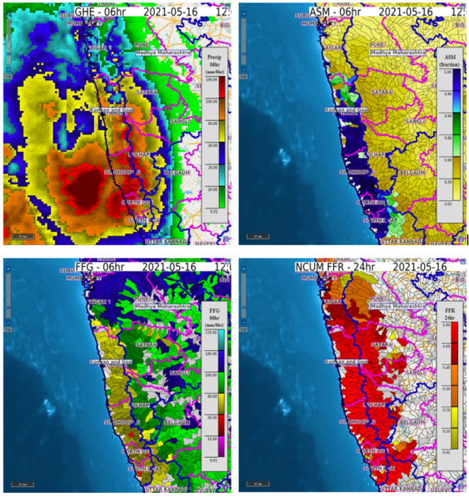
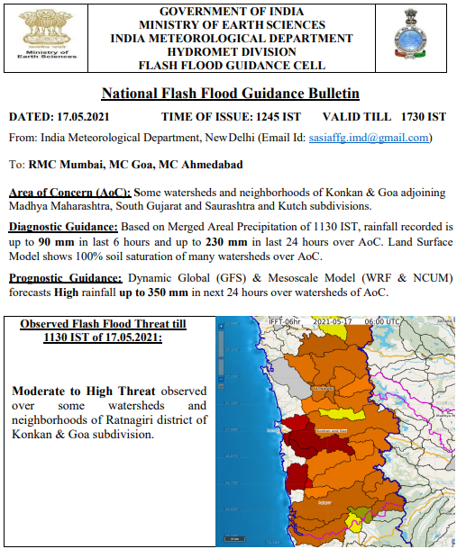
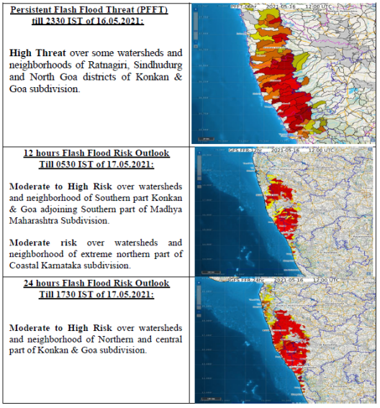
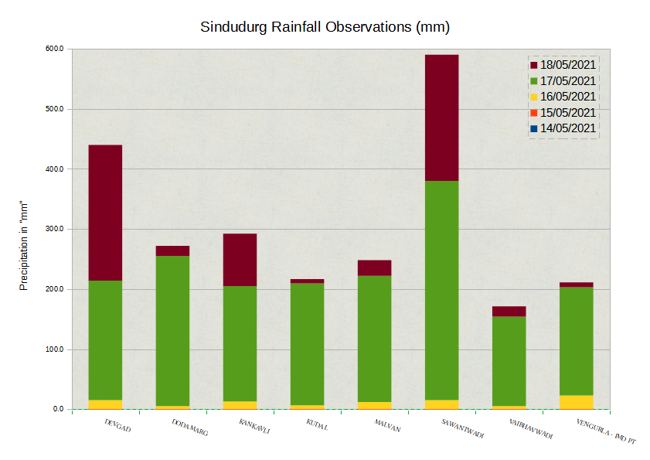
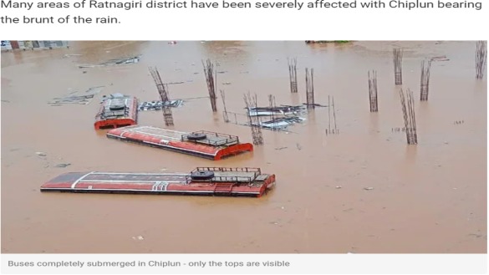
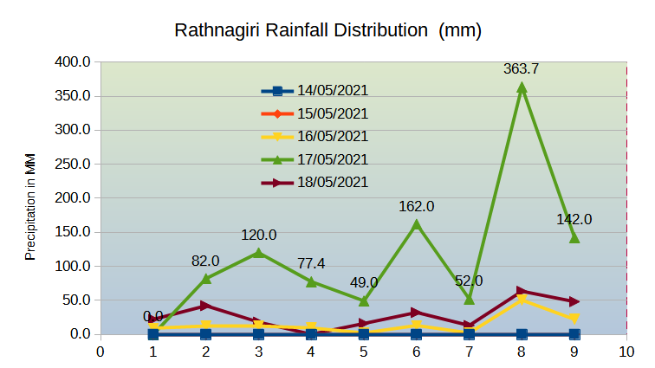
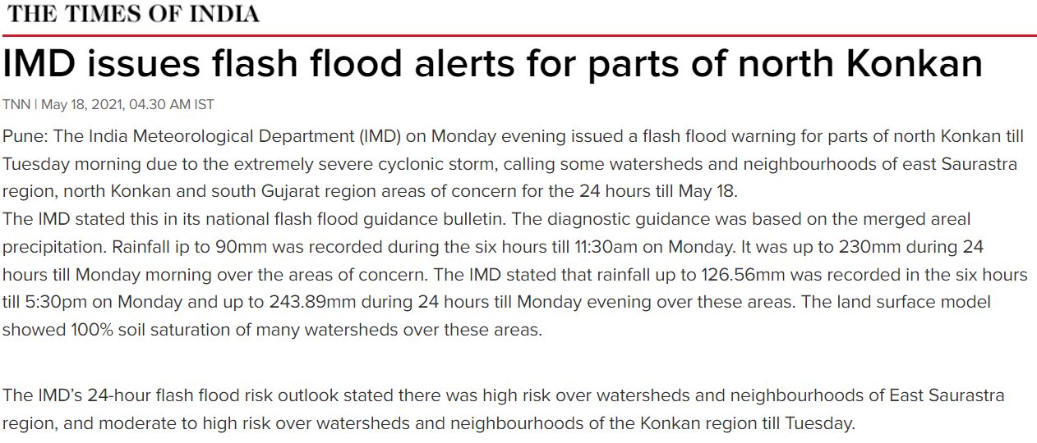
Results & Summary
149
16 Nos. of Operational Alerts issued categorically specifying the threats and impacts up to district level via Emails & Social Media.
6Hr Prior Flash Flood Threat
24 Hr Prior Flash Flood Risk
Note: Manuscript accepted for publication
The present work evaluated the utility of GIS based interactive dynamic applications in severe weather forecasting viz. (FFGS) complimented by the outputs from the Doppler Weather based NOWCAST for the operational meteorologists and hydrologists for issuing impact based flash flood guidance alerts at watershed level.
These guidance alerts, when used along with the real- time socio economic data by the disaster managers would help in making effective impact based decision management at critical times.
Acknowledgements: Regional Centre (South Asia), RSMC, HRC, WMO, NOAA, NWFC

